Slide 1
Welcome to Optimization
Michael Watson
Ehsan Khodabandeh

Slide 2
Welcome!
Introductions
Class Logistics
Combination of lectures, discussions, and in-class exercises
There is always room for questions, comments, and relating your experiences
Please keep us posted (with at least an e-mail) with any attendance problems
If you use a laptop, just use for notes or exercises– distracting to those behind you and obvious to us
Homework Tips
Don’t expect the workload to be evenly distributed- there is too much of a mix
Better homework assignments:
Are clear, concise, and well-written
Are “correct”– units match up, answers make intuitive sense
We treat going over the homework like a lecture– bring notes on what you did, questions you may have had, and extensions of the assignment. You can learn a lot from this
Homework groups: We’ll assign and switch up periodically
We like to go fast and cover a lot- feel free to ask questions
The more you put into the class, the more you will get out of it

Slide 3
Course Overview
Optimization Overview. What is it? Why is It Important?
Linear Programming. The quintessential optimization technique
Integer Programming. Creating more realistic (but harder to solve) models
Heuristics.
Practical. We want you to use this. It applies to many organizations. This course will cover a lot of applications. We are not going deep on theory.
Hands-On. Learn to write and understand models. Build intuition

Slide 4
Optimization Overview
What is it? Why is It Important?

Slide 5
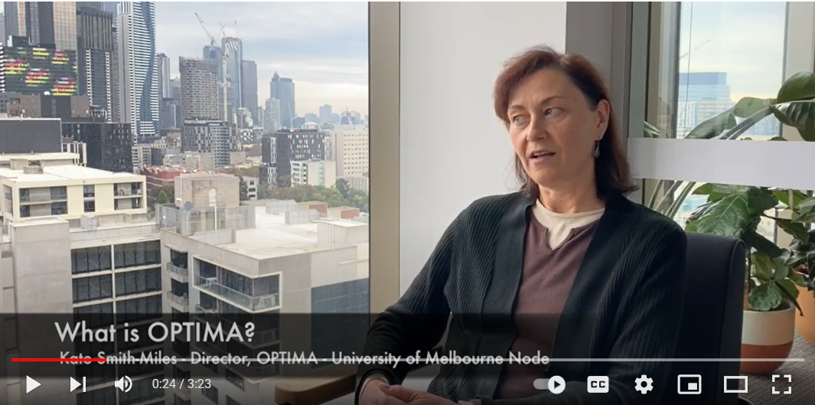
What is Optimization? Why Important?
What did you take away from the first two minutes of the video?

Slide 6


What is Optimization?
Slick Oil Co – Distribution Problem
They have turned to YOU for advice!
Slick recently signed on a new large customer
The customer has committed to purchasing 100,000 barrels of oil over the next year
After celebrating the deal, Slick now needs to choose which wells and refineries they will use to satisfy this new customer’s demand
All their potential wells and refineries are already built and ready to be used so no fixed cost will apply (we assume this is sunk)
Each well and refinery has its own cost per barrel and capacity
Not all refineries have the ability to receive oil from all wells
All refineries ARE able to service this new customer location though

Slide 7
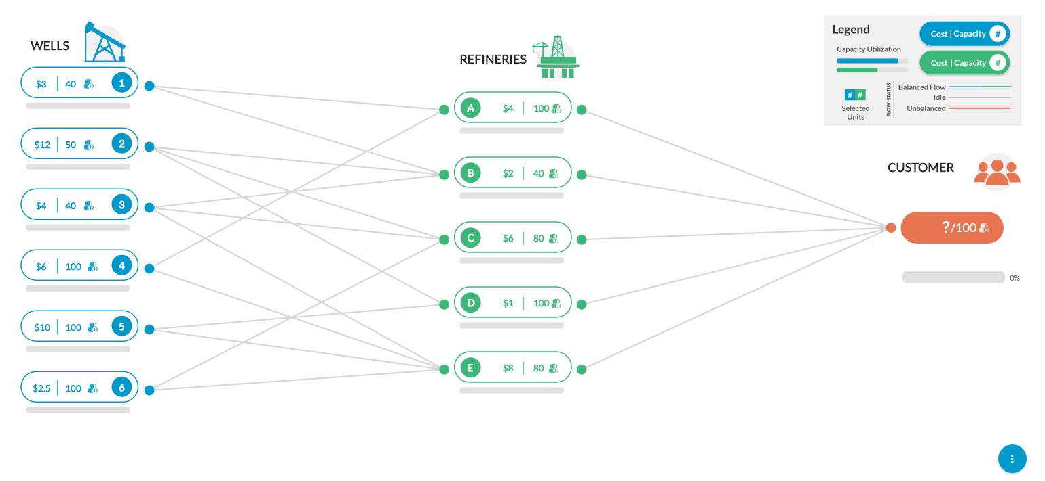
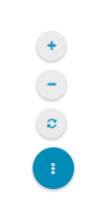
We used to have a cool on-line version.
Slick Oil Game
Zoom In/Out for best fit to Screen
must ship 100 barrels to customer
Reset the Game
can only ship on designated lanes

Slide 8
Slick Oil Game- Zoomed In

Slide 9
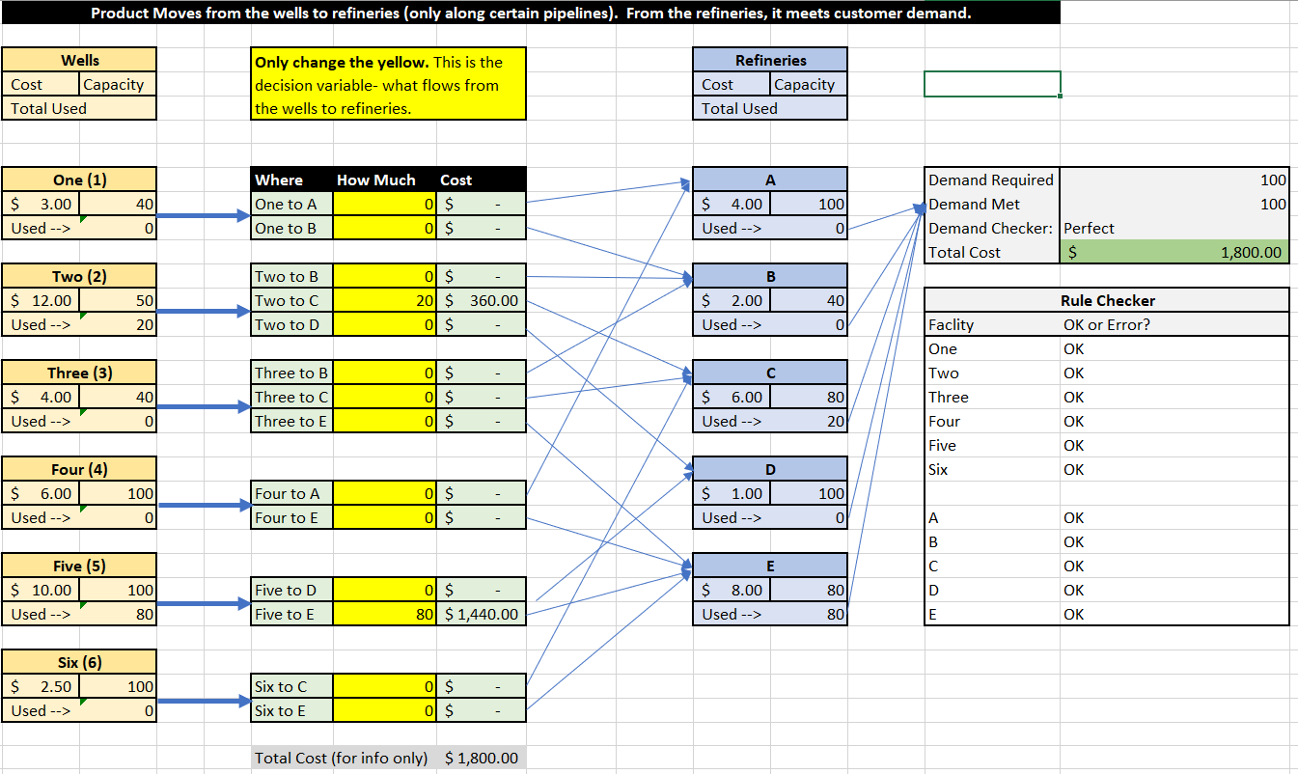
For now, we’ll use an Excel Replica

Slide 10
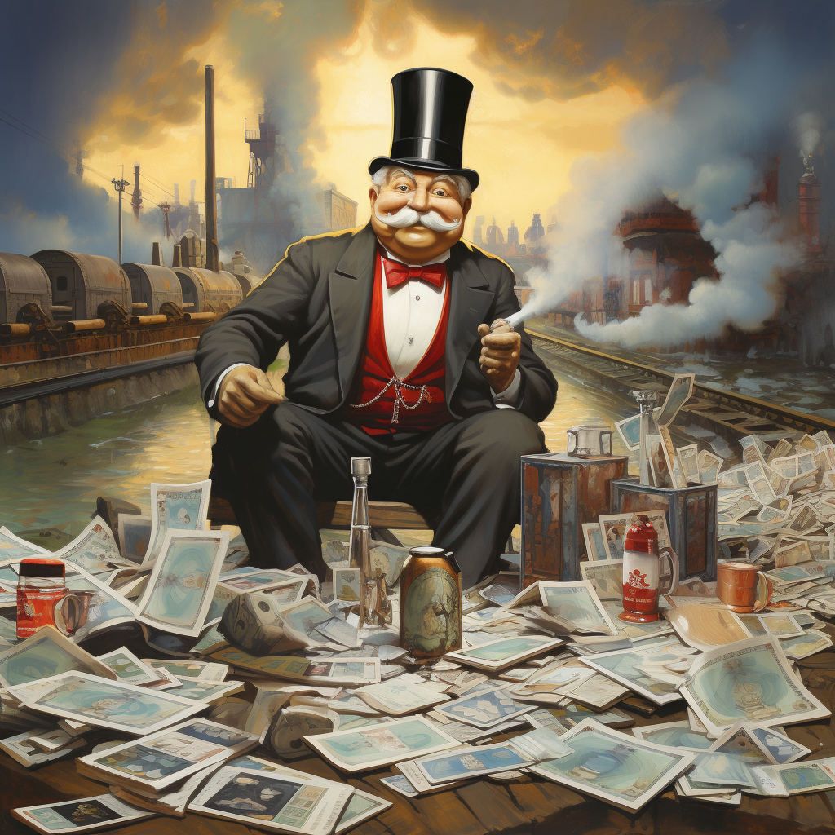
Here’s a solution the guy on the right would like you to implement…

Slide 11
You can do better! What is Optimization?
Slick Oil Game- Scenarios to Test
Easy solution with sites that can meet 100 units of demand
Cheapest Well, followed by cheapest Refinery
Cheapest Refinery, followed by cheapest Well
Cheapest Combo of Well and Refinery
Can you do better???

Slide 12
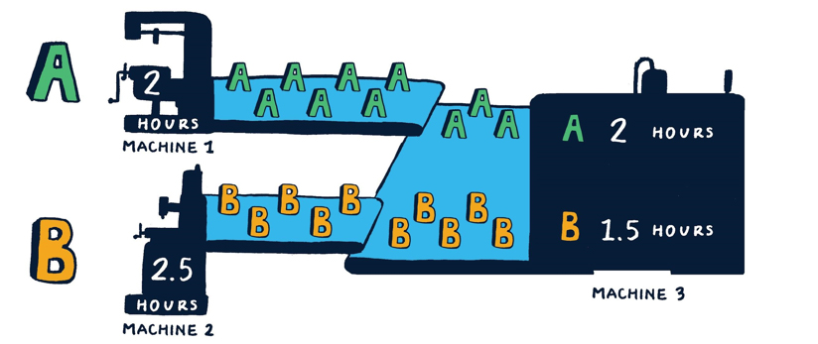
Model Two: Another Simple Factory
Makes 2 products, A and B
3 Machines
A and B share Machine 3
21 days/ month x 16 hours/day
Our Mission:
From an Accounting point of view:
What product is most profitable?
What should the plan be?
Can you do better? Why?

Slide 13
Cheapest Airline Ticket from Chicago to NY?
Ticket Prices:
Airline 1: $250
Airline 2: $225
Airline 3: $205
Airline 4: $275
Airline 5: $230
What is the best strategy?
What if you were doing this for a product sold at 1000s of retailers?

Slide 14
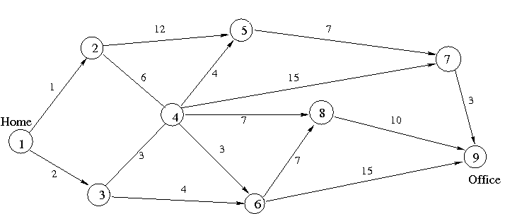
What is the Shortest Path from 1 (Home) to 9 (Office)?

Slide 16
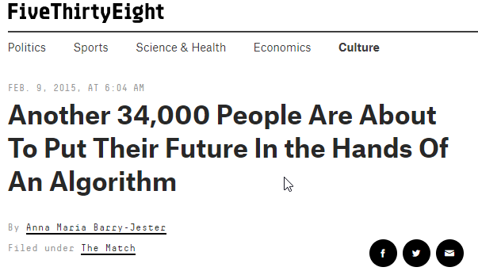

Even Matching is Hard… Residency
Source: https://fivethirtyeight.com/features/another-34000-people-are-about-to-put-their-future-in-the-hands-of-an-algorithm/

Slide 17
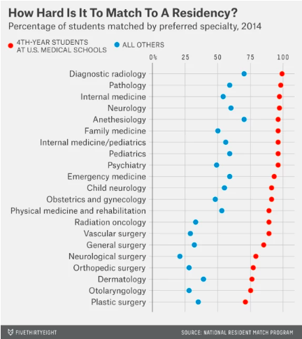
Even Matching is Hard… Residency

Slide 18
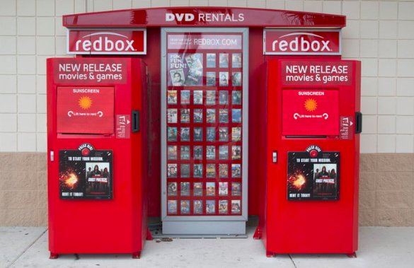
How Does Optimization Compliment Prediction?
Optimization Problem?:
Prediction Problem:

Slide 19

How Does Optimization Compliment Prediction? Beauty Catalog
Prediction Problem:
Optimization Problem?:

Slide 20
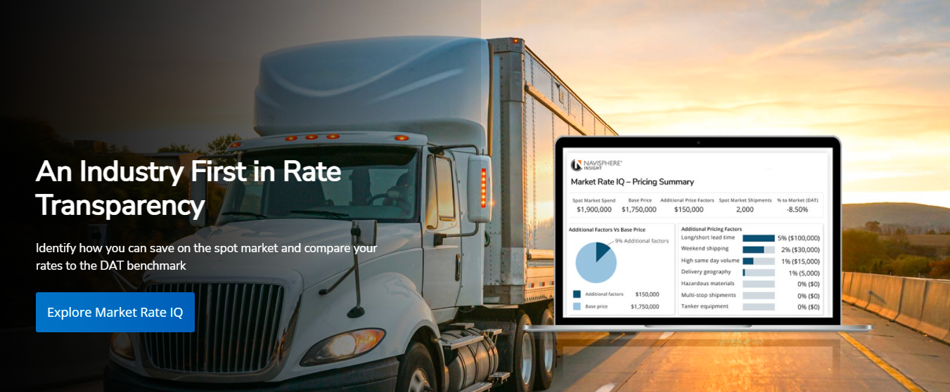

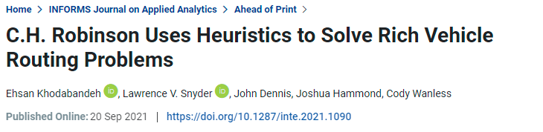
Optimization to Create Customer Engagement
Challenges:
Revenue Benefits:
105,000 Customers
73,000 Carriers
200,000 (and growing) loads per year
Many constraints and rules for the routes
“Optimizer capabilities has helped us secure several large customer opportunities…”
The technical capability helps increase customer engagement

Slide 21

How would you schedule nurses at a large hospital?

Slide 22
Why is it Difficult to Schedule Nurses at a Large Hospital?

Slide 23
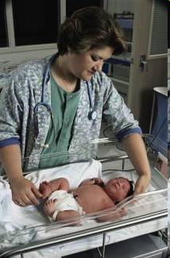
What Would be the Benefits of Good Scheduling?

Slide 24
NBC– Selling TV Ads
60-80% of all Ad space sold in a 3-week period in May for the upcoming season
What the advertisers want
What NBC wants
Result: $200M in extra revenue

Slide 25
Kidney Donation
If a person needs a kidney transplant…
Kidney transplant from a live person lasts about 16 ½ years versus 8 ½ years if from a deceased person
3-5 years waiting for a deceased person’s kidney
Person lives 10 years longer with a transplant than if you stay on dialysis
Healthy people only need 1 kidney, but can only be a donor if…
The blood types are compatible
There are no other antibodies in the blood that make it incompatible
How do you solve this problem?
Donor A
X
Recpt A
Source: http://rcdn-3.brainsonic.com/c1/cdn/3/customers/ilog/20090203_dialog09/large_player/d2_r2_7.html

Slide 26
Kidney Donation
If a person needs a kidney transplant…
Kidney transplant from a live person lasts about 16 ½ years versus 8 ½ years if from a deceased person
3-5 years waiting for a deceased person’s kidney
Person lives 10 years longer with a transplant than if you stay on dialysis
Healthy people only need 1 kidney, but can only be a donor if…
The blood types are compatible
There are no other antibodies in the blood that make it incompatible
Donor A
X
Recpt A

Slide 27
Kidney Compatibility is Only One Factor

Slide 28
Creating Kidney Swaps
1
8
2
7
3
6
4
5

Slide 29
Creating Kidney Swaps
5 pts
1
1
8
2
8
2
5 pts
20 pts
7
3
7
3
20 pts
20 pts
6
20 pts
4
6
20 pts
4
5
5
4 Matches- 50 Points
3 Matches- 60 Points
Don’t give your reasons….
What solution is better?
I’m going to give you no more information

Slide 30
Creating Kidney Swaps
5 pts
1
1
8
2
8
2
5 pts
20 pts
7
3
7
3
20 pts
20 pts
6
20 pts
4
6
20 pts
4
5
5
4 Matches- 50 Points
3 Matches- 60 Points

Slide 31
Recent Article on Kidney Exchange

Slide 32
Given you have an objective, what makes optimization hard?
1
8
2
7
3
6
4
5

Slide 33
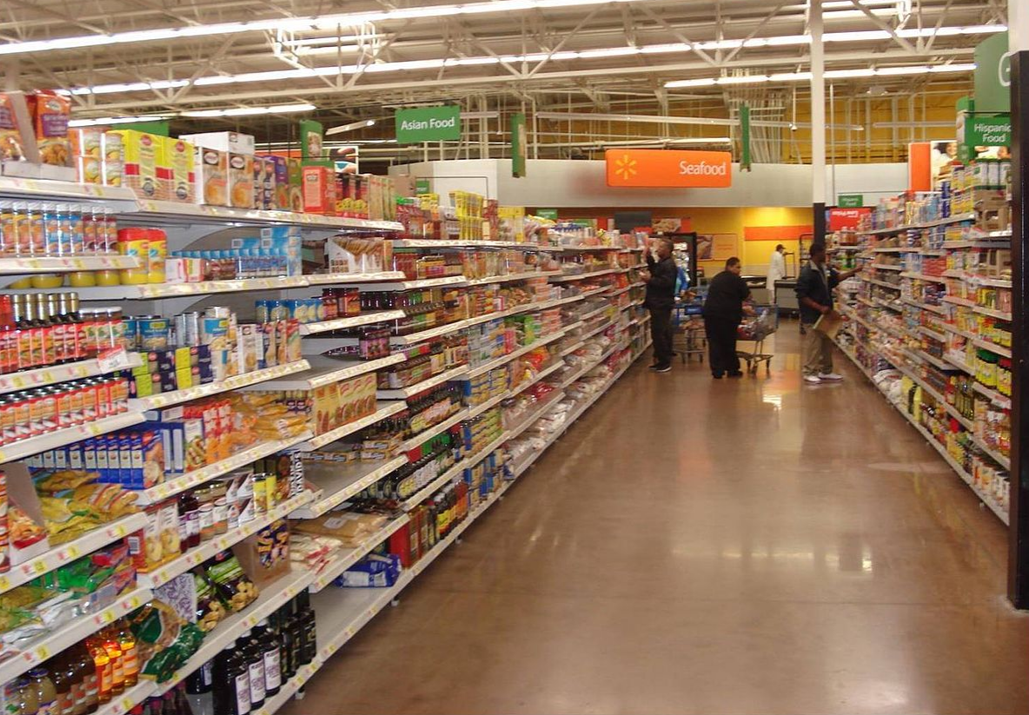
Have You Ever Wondered How Stores Decide Where to Put Items?

Slide 34
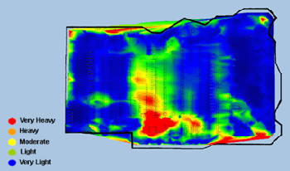
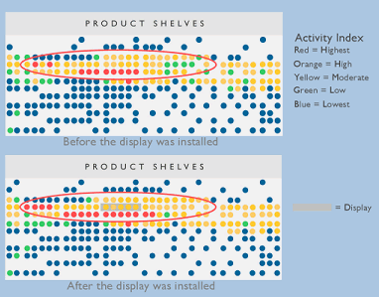
Retailers Understand Where Shoppers Are and Where They Buy
Heat Maps Track Where Customers Spend Time
Heat Maps Can Track Impact of Changes to the Store
Kroger's is merging heat maps of where people spend time and where they spend money
Source: maps from TNS-Sorenson

Slide 35
Optimization Can Help Determine Where To Put Categories
1
2
3
4
5
6
7
8
9
10
C1
C3
C5
C4
C2
Store Traffic
11
12
13
14
15
16
17
18
19
20
Product Category | Quantity | Location
C1 | 300 | 1
C2 | 500 | 9, 10
C3 | 1000 | 2-6
C4 | 300 | 8
C5 | 200 | 7
… | … | …
The system then decides product category quantities and locations; In larger stores, it also is considering what categories go next to each other
Source: IBM

Slide 36

Optimization Can Determine Where Product Goes on the Shelf
1
2
3
4
5
6
7
8
9
10
C1
C3
C5
C4
C2
You now want to lay out the items on the shelf and develop a detailed planogram
High
A
E
C
H
Eye Level
B
D
F
I
K
J
I
L
M
Low
Source: IBM

Slide 37
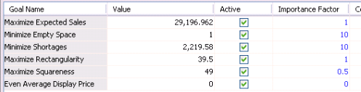
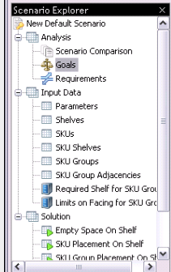
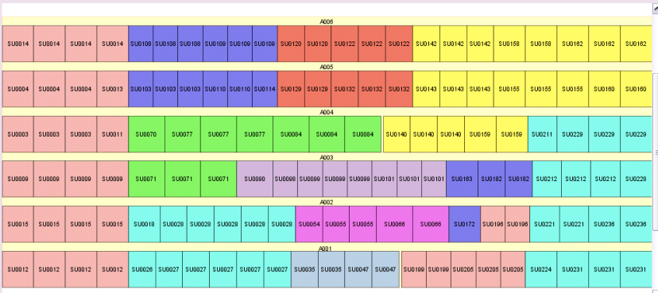
What Goes Into the Optimization?
1. Solution is driven by many conflicting goals with different importance.
2. Detailed inputs describe expected sales, SKU sizes, shelf and floor space requirements.
3. Solution shows the layout of the SKU’s on the shelf, colored by family. Many options for visualizing the display
Source: IBM

Slide 38
What Other Special Considerations Go Into the Optimization?
It is clear you have many objectives…
What are these?
Source: IBM

Slide 39
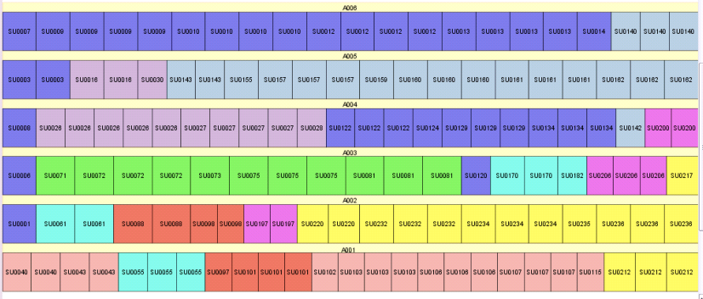
Importance of Detailed Constraints and Multiple Objectives
Solution Considering all Goals
Solution To Maximize Profit
Source: IBM

Slide 40
End of Section

